Slide 1

Take Charge of
Your Life

Slide 2
Our aim
“To provide a learning program that can empower people with knowledge and skills to create a mentally healthier life for themselves”
This course offers an introduction to the internal control psychology “Choice Theory” developed by psychiatrist William Glasser
Notes:
William Glasser was an American psychiatrist who used a counselling approach based on his theory of behaviour which he called Choice Theory. Glasser dedicated his working life of 40 years to counselling, teaching and writing about his theory in the hope of empowering people all over the world to look after their own mental health. He died in 2013. Last year the William Glasser International developed this course as a Tribute to his life and in an effort to carry on his work. It is a great privilege to be able to share these ideas with you.
At the end of each section of the course we will discuss as a group how each idea or skill is linked to mental health and wellbeing.

Slide 3
Take Charge of Your Life program
Session 1 : Shift your Mental Model
Session 2 : Discover Your Basic Needs, Wants and Beliefs
Session 3 : Create Positive Relationship Habits
Session 4 : Learn the Power of Perception
Session 5 : Understand more about Behaviour
Session 6 : Take Charge of Your Life
Notes:
The course is organised into 6 sessions. We will complete 2 tonight.

Slide 4
Take Charge of Your Life
Session 1
Focusing on things that we can control – ‘shifting our mental model’
“How much anguish do we create trying
to change things that we have no control over?
What do we have control over?”
Notes:
We will be talking about what we really do have control over in our own lives.
By the end of this session we will have had time to question how much external things do control us and whether we in fact have a choice.

Slide 5

“Who am I?” : Six Questions
Who am I ?
What’s important to me?
What will I do for you?
What won’t I do for you?
What will I ask of you?
What won’t I ask of you?
Notes:
Who am I?
Family and Youth Counsellor with WCYCS - wife, mother , grandmother. Lived here on EP for 40 years!!
Important – helping people look after their own mental health.
Building connections between people in the community.
Here -
Having a safe environment here to work in – where people respect each other
That participants have fun and connect with each other and have the opportunity to learn new ways of looking at things and also have ask questions and give opinions.
Do –
work hard to provide this information in a fun, interesting and clear way,
aim to finish each section on time,
respect people’s right to choose their own level of involvement,
listen to questions carefully.
Make another time to follow up anything that a person wants to ask about if time doesn’t permit in session.
Respect confidentiality. Tell only my own stories or those of others which are public or for which I have been given permission
Protective interrupting – stop someone from disclosing information that might not be appropriate in a group setting
Won’t do –
Expect you to agree with everything I say
Tell you what’s important to you
Will ask –
People to show respect for each other in the group
That people participate to the extent they are comfortable
people to consider carefully how much personal detail they wish to express,
people to tell only their own stories,
for confidentiality to be respected outside the group,
people to be on time at beginning of sessions
people to answer some research questions to help the designers of the program.
Won’t ask –
people to share anything personal unless they choose to
take part in an activity if they do not wish to.

Slide 6


Introductions
Choose a card that appeals to you, one that you could use to share one thing about yourself with the group.
Introduce yourself and tell us what attracted you to that card.

Slide 7

Why Learn Choice Theory?
Refer to page 5 of Participant Manual
Notes:
Go through the benefits page 5 of PM

Slide 8

Activity: External Control beliefs
1. Pair up and discuss the 3 questions on external control on P6 of your manual.
2. For each question, circle your answer and your partner’s too.
Please answer the question at the top of
page 6 - individually.
Notes:
Share a comment from each pair about whether they were in agreement

Slide 9
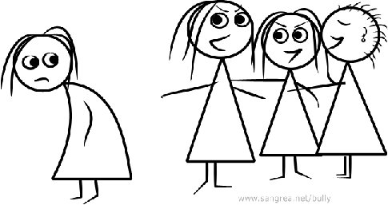
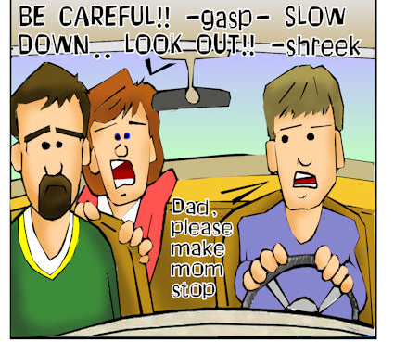

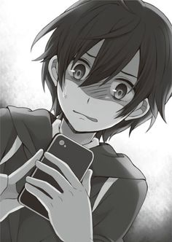
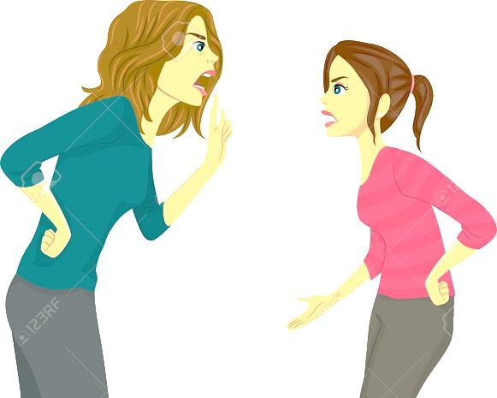

In some situations we can quickly feel out of control BUT…

Slide 10


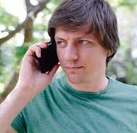

Can things actually control us?
Why do you stop at a red light?
Why do you answer your mobile?

Slide 11


Can people actually control us?
Can someone make you do something without your consent or choice? Teachers? Parents? Friends? Coaches?
Can someone make you think something? Are your thoughts inside or outside of you?
Can someone make you feel something? Are your feelings inside or outside of you?

Slide 12
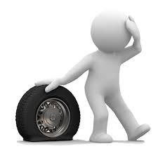

Can the world around us control us?
What are some of the everyday things that happen in the world around you that “upset” you or throw you “off balance” ?
THINGS PEOPLE THE WORLD
But do they actually control us?

Slide 13
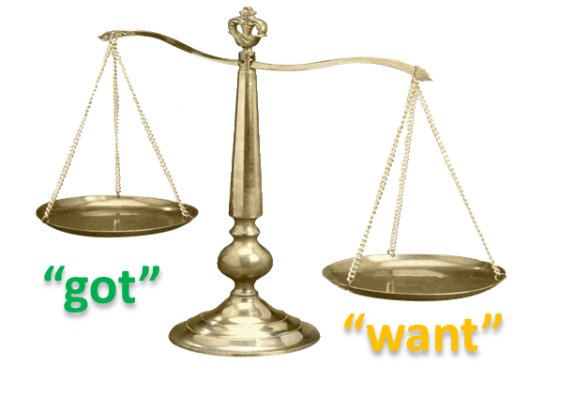

Who is in control of us?
How do we know when we are in balance?
What does it feel like to be off balance?
Do we have a choice of how to respond?
Does the outside world or other people control us? Does anyone?

Slide 14

The outside world and other people are really just information that may or may not be relevant to you – may be an influence …or not

Slide 15
Rubber Band Experiment
Find a new partner you haven’t worked with today
On a piece of A4 paper draw one largish dot
Each partner take a rubber band and loop your rubber bands
Hold the other end of your rubber band firmly
Negotiate who will be “the outside world with total freedom” to do anything they want with the rubber band
The other person is the “control system”

Slide 16

Rubber Band Experiment
Activity
Trial 1: The “control system” has the job of keeping the knot over the dot. Try this for a minute or so
Trial 2: Now each person chooses a dot but does not share where it is. They can both be the “control system”
Trial 3: Agree on a single dot and both attempt to control for the knot over the dot
Notes:
The control system is the person.
The dot represents “what the person wants”.
The knot is “what they’ve got” .
We want to control where the knot is to get it over the dot then “what we’ve got” matches “what we want” and we are “happy” or “in balance” or “ok”
First time
What % of time were you able to keep the knot over the dot?
What did you do to succeed?
Did you negotiate?
Not sharing where the dot is:
What was your success rate?
Can you tell why?
Did you eventually target your dot?
What happened if you did?
2. Both try for knot over dot
How did that work?
What do we know about the real world and the control systems in the world?
How did this experiment represent human beings in society, in relationships?
How much control do we have over others?
Look at relationship habits that people use to control – ideas from group

Slide 17

Activity: What can I control?
(Refers to Page 7 in Participant Manual
but we will use a handout sheet )
Notes:
Choose one column to do

Slide 18

What can I control?
“ The only behaviour we can control is our own.”
“ Nothing we do is caused by what happens outside us.”
“ It is hard, if not impossible, to love someone who wants to control and change you or someone you want to control and change.”
Dr William Glasser
Notes:
Go through page 8 – difference between external control and choice theory

Slide 19

External Control
Psychology
Choice Theory
Psychology
External signals motivate my behavior.
I can control what others do/think/feel/their body.
I know what is good for others.
I have a moral obligation to change others, even if I have to force them.
My wants and needs motivate my behavior.
I can only control my doing/thinking/feeling/body.
Every person has their own best way of living their life.
I can help others find more effective choices only if they want the help.
Notes:
A change from a belief in external control to a belief in internal control means we look at things from a different perspective, focussing on what is going on inside of us and the choices we are making, rather than what the world is doing to us, what we can do to or get from the world around us.

Slide 20

Language, Control, & Responsibility
External
Internal
Made me feel/think/do
I felt/thought/did…
It scared me/surprised me…
I got scared/surprised
Incorrect
Imprecise
Unrealistic
I had to shout him
I shouted him…
Made me see/understand
I saw/understood…
I had to do it
I did it…
I failed the test
I didn’t demonstrate my learning
Notes:
The language of external control thinking is very different from that of internal control thinking. An internal control perspective means we take responsibility for our thoughts, actions, feelings and the sensations in our body. We can then see that we are empowered to make new choices to bring about changes in our lives.

Slide 21

So…What’s this got to do with our mental health?
What benefits can you see in thinking this way?
(ie from an internal control point of view)
What might be difficult about this way of thinking?
What things in your life are the external factors that you are feeling controlled by at this time? How does this impact on your mental wellbeing?
How could you respond to these factors differently?
So what would you like to “Take Charge of” in Your Life?

Slide 22

In every situation, we can make a choice to focus on what we can control – our own behaviour
This choice can bring us back closer to being in balance
In balance we feel calmer and happier, and think more clearly
We are looking after our mental health

Slide 23

Session 1
Something I now realize…
A situation where I want to try these ideas is …
Notes:
I have this as a handout to collect at the end of the session.

