Slide 1
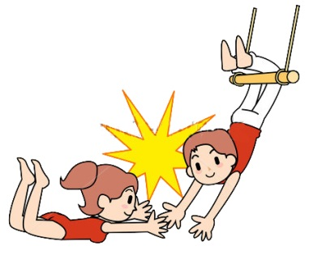
Recapping last week….
Last session
We started thinking about what we can and can’t control
We showed how the ‘Needometer’ can help a person to get a snapshot of which of their needs are being satisfied and which are missing out!
Some people felt that at their age they sometimes had limited Freedom to make the choices they wanted

Slide 2
How did you go?
Did anyone have an example of struggling to keep their “knot over their dot” this week?
Can anyone tell us about a time where they thought consciously about how much control they actually had ?
Can anyone think of how a choice they made satisfied one of their Needs?

Slide 3
Take Charge of Your Life
Session 3
Create positive relationship habits
How much of our joy and suffering involves our relationships with others?

Slide 4
Activity : “Training session from Hell”
Group A
You go to training for netball/football.
You come in late and the coach glares at you saying “ nice of you to finally show up”, we’ve been going for 15 mins already. You’re told to do 3 laps.
The grounds are wet and you slip over.
You tell your friend a joke. The coach tells you to stop mucking around and that you need all the practice you can get because of the appalling way you played last week.
The drills are boring and repetitious.
You miss another set goal. Your team mates groan.
You miss two passes in a row in a drill because the ball is so slippery.
In the change rooms the team is named for the next week are posted and you miss out.
What did you think and say and do?

Slide 5
Group B
You go to training for netball/football.
You come in late and the coach indicates for you to join in the drill.
It is a perfect evening.
It’s pretty relaxed, there is plenty of time for you and your friend to share a few laughs.
The coach points out all the things that went well last week.
The coach has some new drills which are heaps of fun.
You have a go at set goals. The coach encourages you saying, it’s a percentage game – all you have to do is keep getting it up there.
The team is practicing drills. Your friend yells out ‘ 3rd time lucky – you will get it this time.’
In the change rooms the team is named for the next week are posted and you are in the team.
What did you think and say and do?
What did you think and say and do?

Slide 6
“Sports Training Activity” What behaviours did you choose?
What did you want that you were trying to get by using the behaviors you chose?
Did what you were doing bring you closer to what you wanted?
All behavior is purposeful.
You were doing the best that you could at the time to get wanted to meet one or more of your needs.
Notes:
Take a card (previous slide) each and your best guess at what it is designed to do e.g. criticising is wanting the person to do it your way

Slide 7
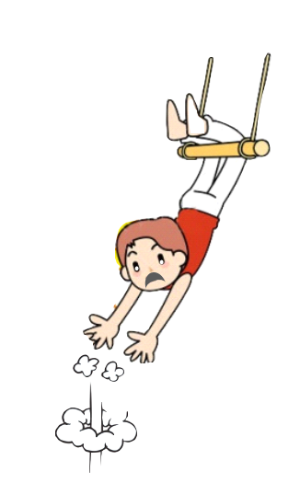
The 7 Disconnecting Habits…
Criticizing
Blaming
Complaining
Nagging
Threatening
Punishing
Bribing
Notes:
Whiteboard – summarise habits from activity. Link to disconnecting habits and connecting habits.
Suggest some other disconnecting behaviours

Slide 8
THE 7 CARING HABITS
Listening
Encouraging
Trusting
Respecting
Accepting
Supporting
Always negotiating differences

Slide 9
What do we mean by ‘relationships’?
friendship
family relationships
intimate relationship
coach - player
boss - worker
…… and many others
A ‘good’ relationship is one where people
both respect each other
get along well, have fun together, share things that are important to them
can work out differences
Notes:
Take a card (previous slide) each and your best guess at what it is designed to do e.g. criticising is wanting the person to do it your way

Slide 10
Choose one of the following relationship situations :
Parent/Child
Teacher/Student
Coach/player
Boss/worker
Boyfriend/Girlfriend
With a partner, invent a situation where there is a
“slight disagreement” between the two people.
Decide which role each person will play.
Notes:
Ask Participants to choose a situation from the above or another.

Slide 11
Activity: “A slight disagreement”
Round One:
Both use only the red behaviours
Round Two:
One of you chooses to use the red habits and one the
yellow habits.
Round Three:
Both parties choose the connecting (caring) habits
Notes:
Round 1
How many of you solved the problem?
How many believe the relationship is better than when you started?
Did the behaviours you used bring the parties closer together or drive them further apart?
Round 2
In addition ask : Was it hard or easy to stick to the kinds of questions and answers that were on your side?
Round 3
Notice body language
Extra processing questions:
What do you think was the difference this time?
Did anyone notice the laughter, body language or facial expressions around the room this time?
Did you personally feel a shift in your emotions or physical comfort level in the third role play? Point out some differencec and applications.

Slide 12
“The Question”:
“If I do or say this right now, will it bring us closer together or drive us further apart.”

Slide 13
Relationships
“All human problems are human relationship problems.”
“ I have noticed that happy people are constantly evaluating themselves, and unhappy people are constantly evaluating others.”
“Success in any endeavour is directly proportional to how well the people who are involved in it get along with each other.”
William Glasser

Slide 14
So…What’s this got to do with our mental health?
In what ways can a “relationship break-up” impact on someone’s mental health?
And two things to think about:
What relationship is most important to you in your life right now? What connecting and disconnecting habits are you currently using?
What connecting and disconnecting habits are you currently using with yourself? We tell ourselves things all the time. What different things could you choose to say to yourself?
Notes:
Negative habits over time – takes practice. When we change a habit we are actually building physical linkages/pathways in the brain. Thinking can change our brains. Norman Doidge “The Brain that Changes Itself”.

Slide 15
Reflecting on the information for today
What habits do you maintain in your relationships with yourself, with others
What habit do you knowingly use frequently in trying to control your close relationships?
How is what you are doing currently working to gain relationships you desire?
Name two relationship habits you will start using.

Slide 16
