Slide 1
Recapping last week…
We feel good when we are
meeting our basic needs –
we have our Quality World pictures
Survival
Love & Belonging
POWER
FREEDOM
FUN

Slide 2
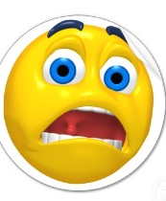
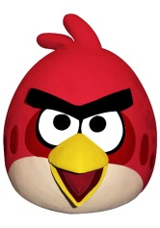
When we are not meeting our basic needs
- we do not have our QW pictures
THEN …we feel out of balance
We feel either angry, worried or sad
Survival
Love & Belonging
POWER
FREEDOM
FUN

Slide 3
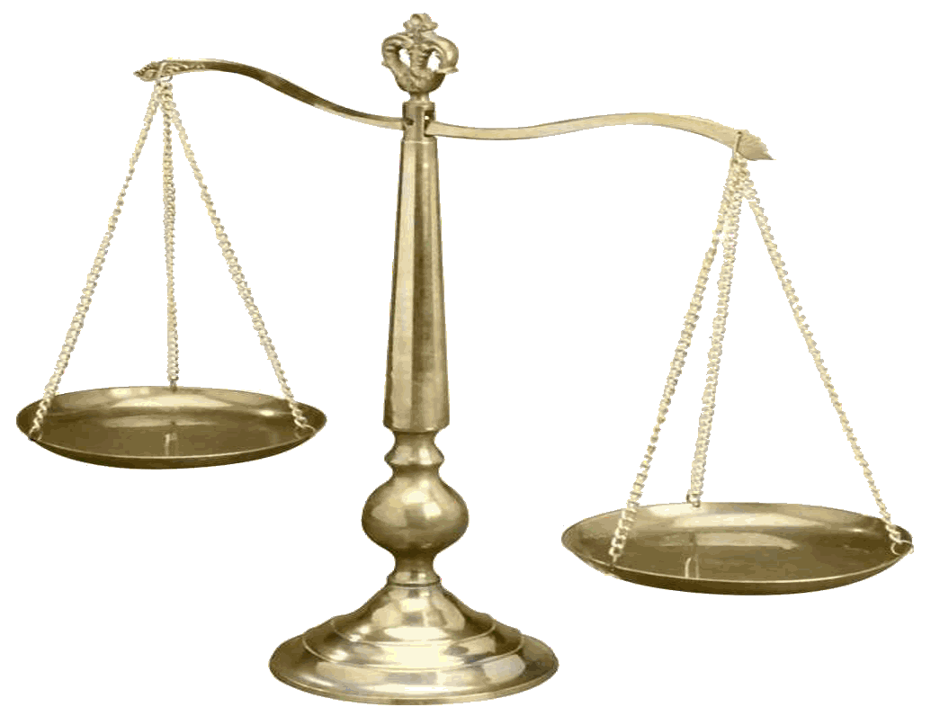
“The Scales”
.
Can be used to describe our sense of being in or out of balance
?
Quality World
QW
“got”
“want”

Slide 4
What’s next?
In this section we will have a look at
what information we are getting from the world around us - what we’ve
“got”

Slide 5
Take Charge of Your Life
Session 4
Learn the Power of Your Perceptions
Why do we think what we think?
The power of our perceptions

Slide 6
What do you see here?
www.theinvisiblegorilla.com/videos.html
Notes:
Important points: We see a portion of reality depending on what we attend to
We cannot attend to everything
We are all seeing the world differently
This is normal and it is the way the brain copes with living in a world with a huge amount of information
When we do not know the gorilla is there, we may look at the gorilla but we do not ‘see ‘ it. When we know it is there, the information passes through to the Perceived world because see it, know of it and value it because we want to be successful at the test.
Takes about 10 mins

Slide 7
What do you see here?

Slide 8
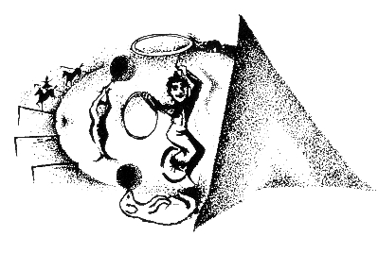
What do you see?

Slide 9
What do you see now?

Slide 10
Mystery Object

Slide 11
The filters
Sensory filter
Takes information in from the ‘real world’ through the senses – sight, hearing, touch, smell, taste
Knowledge filter
Allows information through that we can link to existing knowledge
Valuing filter
Allows information through which we put either a positive, neutral or negative value on
Notes:
Use the chart to show the filters.
How are these filters operating during the gorilla test?
Which of the filters is ‘blocking out’ the info?
What changes once we are told about the gorilla?
When we do not know the gorilla is there, we may look at the gorilla but not ‘see‘ it. ( apparently they tracked eye movements and people do often look at the gorilla but do not register it being there. The information probably passes through the sensory filter but is lost(spike). When we know it is there, the information passes through to the valuing filter. Because we have been primed up to value it, it then passes into the Perceived world because see it, know of it and value it because we want to be successful at the test. All the filters.
What colour do you think the info is?
Information – 20 mins including the optical illusions slides and explaining the chart etc

Slide 13
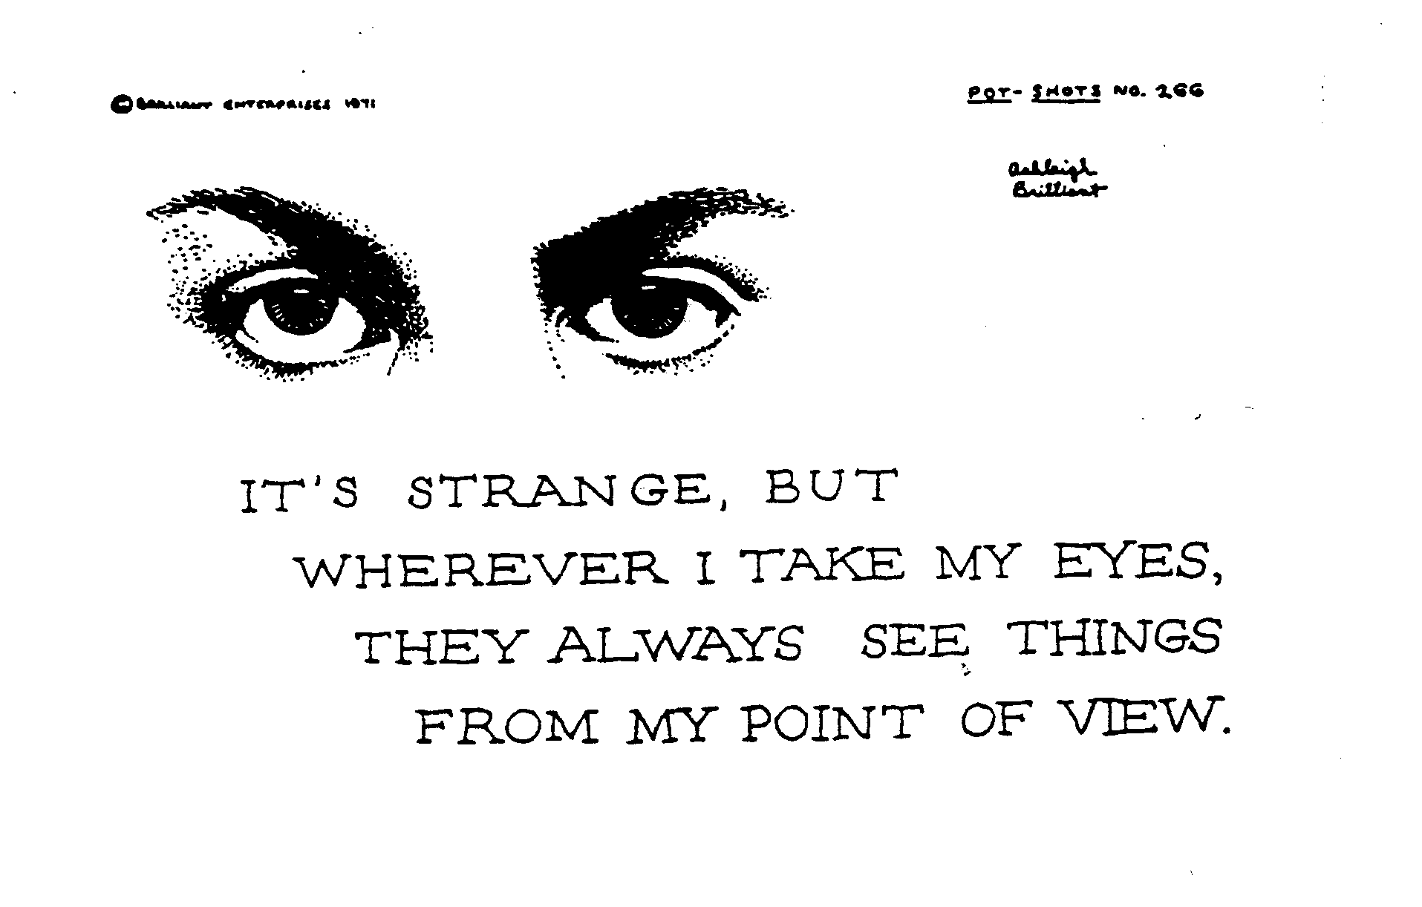
Notes:
Looking for negatives – you will find them and VV
“Blue things” activity

Slide 14
Word Association
When I show the picture or say the word hold up a
Red card if this information is negative for you
Yellow card for positive
Green card for neutral
Notes:
Ask participants to share their initial perception of the word/picture
Add some information about the picture or word and ask if their perception has changed?
Would your perception change if you had further information? What kind? Some examples?
20 mins

Slide 15
“The shower curtain”
Notes:
3 mins

Slide 16
Perceptual System
The only way to change perception is to give significant information

Slide 17
Comparing Place
Frustration signal and urge to behave
“got”
“want”
Notes:
Use chart to explain the Comparing Place
Comparing perception we have (from the info that has got into the PW) with the QW pic we have. If the info is RED the scales will be tipped and we will automatically feel the urge to do something to get back in balance – to behave.
If info is YELLOW the scales remain in balance and we will feel a good feeling.
Story examples
7 mins

Slide 18
Perceptual System
“One of the most difficult lessons to master as we struggle to create effective change is to learn not to label something as bad just because it is different from what we want.”
“When we label anyone ‘bad’ we will have more trouble dealing with him than if we could have settled for a lesser label.”
William Glasser

Slide 19
So…What’s this got to do with our mental health?
What benefit do you see from being more aware that your perception is not the “whole story” of what is happening at a particular time?
How can our perception influence our communication with one another? Our relationships? Our behaviour?
What happens when what we want doesn’t match what we’ve got? How do we feel?
Notes:
Negative habits over time – takes practice. When we change a habit we are actually building physical linkages/pathways in the brain. Thinking can change our brains. Norman Doidge “The Brain that Changes Itself”.

Slide 20
Perceptual System
“One of the most difficult lessons to master as we struggle to create effective change is to learn not to label something as bad just because it is different from what we want.”
“When we label anyone ‘bad’ we will have more trouble dealing with him than if we could have settled for a lesser label.”
William Glasser

Slide 21
Implications
We all see things differently
Changes in our knowledge and values bring about changes our perception
Our perception is what we’ve “GOT”
Next week we will look at our behaviour,
which is our attempt to balance our scales.
Perceptual system
QW
“got”
“want”
Notes:
We need to find out what we want in order to feel balanced.

Slide 22
Geometric Close
Notes:
What has squared with something you already knew?
What has completed a circle of knowledge for you?
What do you now see from a different angle?
Is there something that has given you new heart?
What new direction will you now take?
Each person is invited to share one response.

