Slide 1
Take Charge of Your Life
Session 5
“Discover the Why and How of Your Behaviour”
What happens when we don’t get what we want? How can we stay balanced?

Slide 2
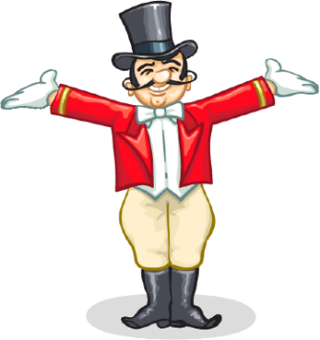
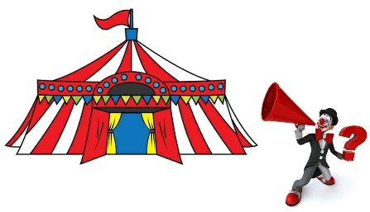
Recapping first session ….
We learnt that
We can choose our response in our circumstances
We make our choices based on the Quality World pictures we have in our heads about what feels good for us
These QW pictures are there because they satisfy our genetically programmed needs – for Safety and Survival, Love and Belonging, Power, Freedom and Fun
Notes:
So far we have learnt how we are in charge of our choices and why we make them.
This week we are going to build on this to learn how we can create more positive, stronger relationships.
Relationships are a core part of good mental health. We all want to feel like we belong and feel loved. Humans are hardwired to connect.
One of the problems when we become mentally unwell is that we withdraw from the people we most need to connect with.
From the other angle - difficulties with relationships can lead becoming to mentally unwell.
We have learnt that there are 5 basic needs. Glasser believes from his 40 years of counselling that relationship problems are at the heart of every mental health problem – including the relationship we have with ourselves.

Slide 3
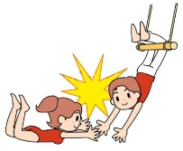
Recapping last week….
Last session we learnt that
We make behaviour choices which either bring us closer together (Connecting/Caring Habits) or drive us further apart (Disconnecting Habits)
That the amount and type of information we take in (our Perceived World PW ) from the world around us depends on our senses, what we already know and what is important to us
That when what we WANT (QW) doesn’t match what we GOT (PW)we feel out of balance ( angry, sad or worried)

Slide 4
Activity:
“Connecting”
Notes:
Look up Look down
What is the purpose of this activity? Have fun. Connect.

Slide 5
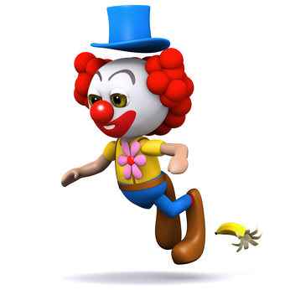
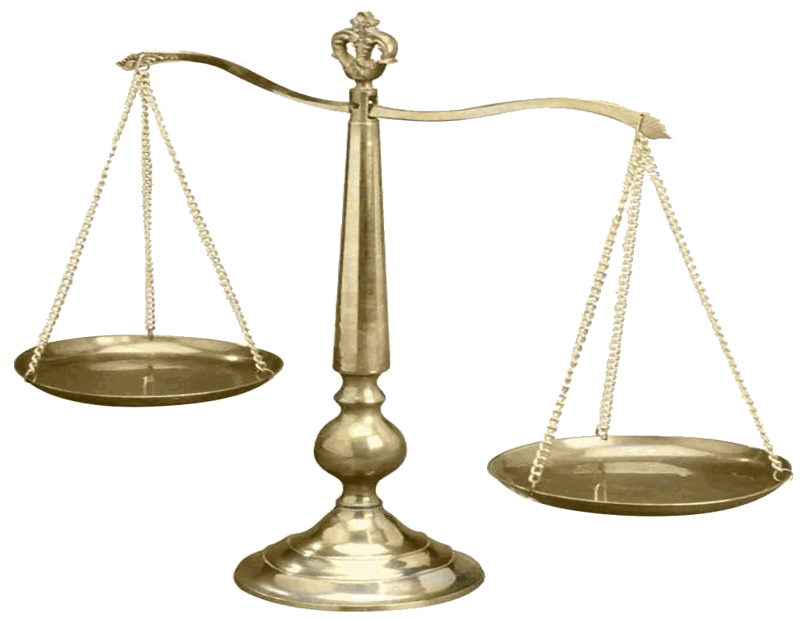
If …“our scales are tipped”
And we are out of balance
we feel either
angry
worried
or ….. sad
we always do something
to try to fix this
“got”
“want”
Notes:
Sometimes the things we do help us feel better and sometimes they don’t
Sometimes they help for a while and then … they don’t
We all need to know how to help ourselves when these feelings happen. Sometimes we need others to help us work it out
In this section we are going to have a look at how our actions, our thoughts feelings and our body responses are all linked together

Slide 6
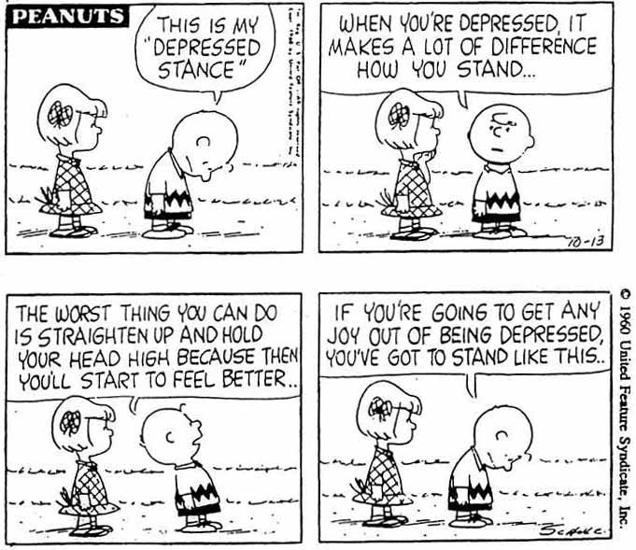
Activity: “Think Red”
Notes:
Thoughts First I am going to ask you to think red, think green and stop thinking green Wait 3-5 secs between each one.
Feelings Now I am going to ask you to control your feelings. Keeping your eyes closed, try to feel angry
Feel sad, stop feeling sad and be happy
What were you thinking when you giggled?
Physiology Next … control your body. Keep eyes closed and raise your heart rate. Lower your cholesterol
Sweat profusely
Actions Now I am going to ask you to control your doing behaviour – your actions
Raise your right hand Lower it. Touch your nose. Stop touching your nose.
Recap what you did.
Of all 4 which is easiest to control – relate to front wheels
What did you do when I ask you to stop thinking green.?We never stop thinking- the thinking wheel is always spinning even when we are asleep
Was anyone able to feel sad or angry or happy when directed to?
- How – thinking. It is our thoughts which control our feelings. The thought info becomes an electrical impulse that travels via the amygdala thru the limbic system , creating a feeling. Spilt second – we are not aware that we create our feelings- they don’t just happen to us
Who could raise their heartrate? How – thoughts – indirect control
Where do you sit – front. What would happen if you sat in the back?
What wheel would represent anger? What would happen if someone let his anger control his behavioural car?

Slide 7
The Behaviour Car
All behaviour is made up of four components:
Actions : what we are doing
Thinking: the stream of thoughts constantly running through our minds
Feelings: our emotions - anger, fear, joy etc
Physiology : all our nonconscious physical responses
(or body talk) eg heart rate, breathing, sweating, muscle tension, hormone levels, brain chemistry etc
Notes:
10 mins
Idea of total behaviour
A Running
T Meditating
F Extremely angry
P Sick to my stomach

Slide 8
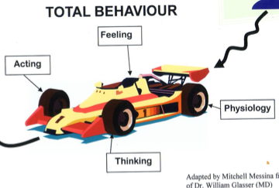
“The Behaviour Car”
Delighted, worried,
frustrated, calm
Sleeping, walking, yelling, crying
Breathing fast, sweating,
heart pounding, tense neck muscles
This sucks, I am confused, This is great!
No one cares…. I am such a loser
I am calm, I can do this
Notes:
7 mins
Introduction to the wheels of the car as metaphor for behaviour as total behaviour
Choose 4 chairs and volunteers. Do following scenarios
Some egs of behaviours that are acting, feeling, thinking and physiology
Driving past Port Neill. Enjoying time together
Stopping at Cowell for an iced coffee- swap drivers
Getting hungry 15 km from Whyalla
Sudden realisation that purse had been on roof of car
Stopping
Turning round and driving back to Cowell
Looking for purse unsuccessfully
Phoning bank
Phoning husband
Good news

Slide 9
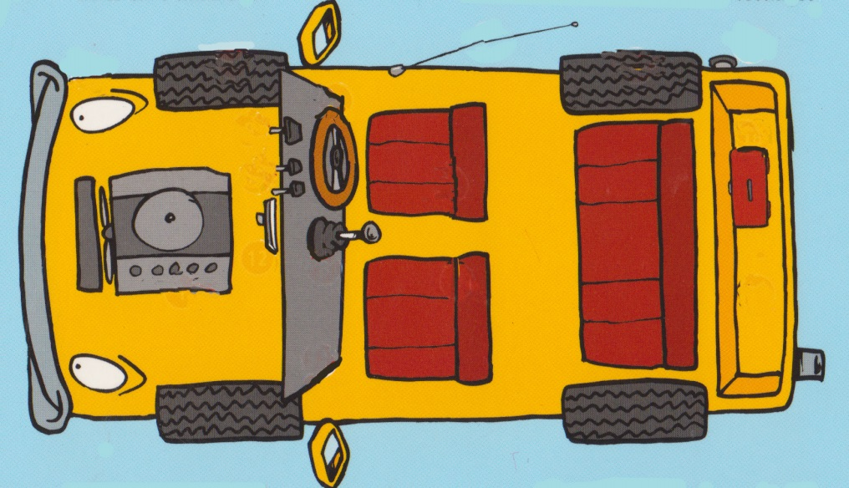
Activity “Reinventing Yourself”
What are my actions?
What are my feelings?
What am I thinking?
What’s happening in my body?
“When are you going to stop reinventing the wheel?”
Notes:
20 min
Example
You have just arrived late to work
Back wheels – Flustered, embarrassed, heart running fast, breathing fast
Front wheels – running, thinking oh no I will be late again! Everyone will see me.
Reinvention
Change running to walking – how does that feel? Physiology?
Change thinking to “ It’s ok, I can explain why I am late. I can make up the time if I need to.”
Were you able to link the questioning process to the 4 quadrants?
Can you see how emotions change when you change your actions or thoughts?
Do you think you can use this process with yourself when you are facing difficulties?

Slide 10
Choosing new behaviours
We can choose an organised behaviour (habit) or we can create a new behaviour.
We must practise this new behaviour before it becomes an ‘organised behaviour’.
We can more easily change our Front Wheels - what we are Doing and Thinking.
Our Back Wheels - Feelings and Physiology -will change when we change our Doing and Thinking

Slide 11
Quotes:
“Good or bad, everything we do is our best choice at that moment.”
“All behaviour is purposeful and made of four components - acting, thinking, feeling and physiology.”
“These are our choices when we want to stop choosing a painful behaviour like ‘angering’, we can
change what we want (QW pic)
change what we are doing (our acting and thinking)
William Glasser
QW
OR
Notes:
Eg I want a new car
Particularly a VW Passat
I can’t afford it
I can – choose a cheaper car – GOLF
Or – choose to sell something else, get a better job, steal money, save a bit longer,

Slide 12
So…What’s this got to do with our mental health?
Think of a time when you were “out of balance”. What feelings come to mind? What about when you were “in balance”?
What is the benefit of noticing and naming our feelings and body talk?
What is the benefit of being aware of what we are thinking and what we are doing when we are ‘tipped’?
If you can use some skills to regain balance how could this lead to better mental health?
Notes:
Negative habits over time – takes practice. When we change a habit we are actually building physical linkages/pathways in the brain. Thinking can change our brains
Kirsty’s eg about having the needle. Norman Doidge “The Brain that Changes Itself”.

