Slide 1
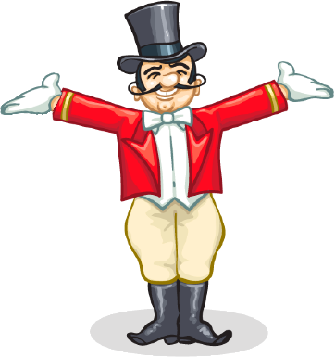
Take Charge of Your Life
Session 6
Take Charge of Your Life
What’s your plan?
How can we take more responsibility for our own mental health?
Creating a plan to support our own mental well being.

Slide 2
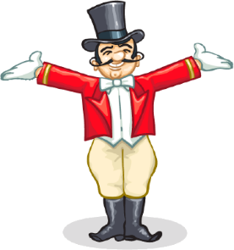
As a “mentally healthy” person
you enjoy being with most of the people you know, especially the important people in your life such as family and friends.
you are usually willing to help a colleague or friend to feel better
you live a mostly tension free life
laugh a lot, have few aches and pains
you enjoy life and have no trouble accepting that other people are different from you and you don’t try to change other people
in difficult situations you might be unhappy, but you generally know why you are unhappy and will try to do something about it
William Glasser (paraphrase)
Notes:
Emphasis on relationships
No guarantees of being happy all the time. A person who is mentally healthy would know how to do something about the way they are feeling. Sometimes it is appropriate to be sad for a while. People are in charge of how long they stay with ‘sadness and when it is time to find a way to get back in balance. Being more mentally fit is about having more tools and skills to regain balance. Much of it is about understanding yourself.
When we are happy we usually want to stay that way – it is the uncomfortable feelings of sadness, fear and anger that we want to change.

Slide 3
OR
We feel good when we are
meeting our basic needs –
we have our Quality World pictures
Survival
Love & Belonging
POWER
FREEDOM
FUN

Slide 4
Take Charge of Your Life
Session 6
Activity: The Line
1
10
Notes:
That’s me – quick warm up. About 5 mins.
One the Line – people move either to stand on the line or not according to the statement
Debrief:
What was going on in people’s minds as the statements were read out?
Anyone surprised at their own answers or someone else’s?
Is there any change in your thinking from this exercise?
What will you remember about this exercise?

Slide 5
Self- evaluation
Use the magnet sliders on the Needometer to show “how life is” for you at the present time
If YOU could choose one need to have more of, which would it be?
Think of some things YOU really want to HAVE, DO or BE in your life (now).
Choose one.
Imagine this did happen– slide the magnets to show what would change for you.
Notes:
Ask people to self evaluate where each need is and to give examples of the QW pictures they have of this need being satisfied.
The needometer will give a clue as to a need that might be missing out.
Hand out paper for notes

Slide 6
“WDEP”
W: What do I want – really, really want?
D: What am I doing and what have I been doing to get what I want? What am I thinking….
E: Is what I am doing and thinking helping me to get closer to what I want?
P: What options do I have that could help me get closer to what I want?
Now that I have chosen the “most likely to succeed” option, what is my plan to get me what I want?
**WDEP = Want, Doing, Evaluate, Plan
Notes:
Use personal lives and realistic wants and goals.
Eg W want to go to Adelaide to a concert with my friends
D Thinking about it. Thinking about asking mum
E – not really
P – ask mum
E closer but she said she can’t afford it
P ask if she can lend money if I get a job
E closer – I have to get the job
P write my resume
E closer but don’t have a job
P hand out resume to shops
E closer
P go back and ask at shops. Talk to friends about jobs.
Handout sheet and scrap paper

Slide 7
Finishing off…
Think - about the two questions above the table on p26
Pair - turn to the person next to you
Share – talk together about your answers
Complete the
Table on page 26 for yourself
Research Question sheet that is handed out

Slide 8
“You have brains in your head
You have feet in your shoes
You can steer yourself
Any direction you chose

Slide 9
You’re on your own
And you know what you know
And you are the one who’ll decide where to go…”
Today you are You, that is truer than true.
There is no one alive who is Youer than You”

